Slide 1
Barracuda Log interpreter
BL-RFP

Slide 2
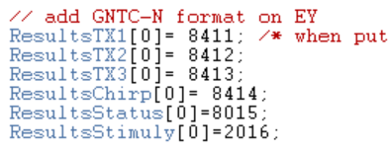
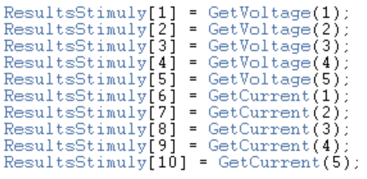
Log interpreter
Log ID (block ID)
8411, 8412, 8413, 8414: temperature Tj
8015: error code
2016: voltage and current

